Slide 1
Factorial calculating program
A program that calculates factorials by Group 2

Slide 2
What is a factorial?
A factorial is the product of multiplying a given integer by all of the integers below it.
Example: 7! = 7 * 6 * 5 * 4 * 3 * 2 * 1 = 5040

Slide 3
Pseudocode
1) Variables: num, fact, start 2) Input: num 3) Input Validation: num>=0 and num <=20 4) fact = 1
num > 0 : loop for start = 1, end = num ⇔ (1, num+1) fact *= start num == 0 : "fact = 1"

Slide 4
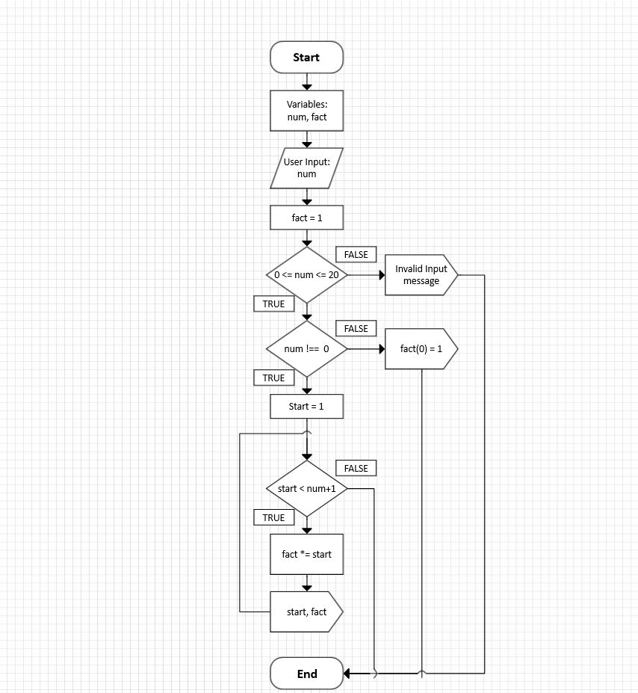
Flowchart

Slide 5
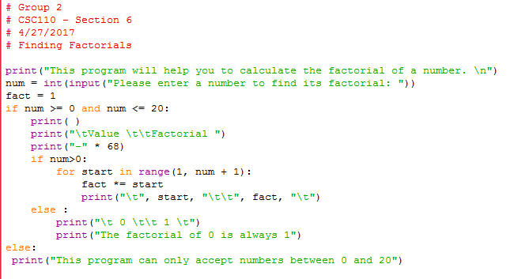
Final code

Slide 6
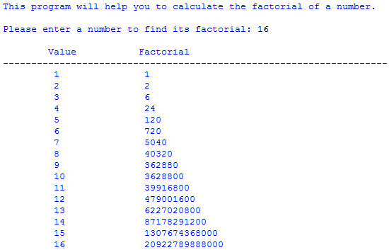
Examples

Slide 7
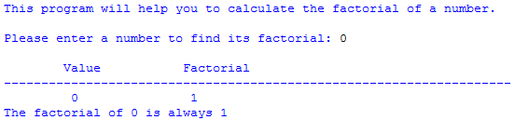

Examples
Always prints (not calculates) 0! as 1
Rejecting numbers outside the acceptable range

